Slide 1
CS143 Discussion Section Week 4
Jia Teoh
slides borrowed from Ariyam Das
Notes:
Jason’s discussion: google form on piazza too if you have feedback :D

Slide 2
Trees vs. Hashing
Hashes good at:
Equality
k == 1
Because:
Ideally one lookup!
Trees good at:
Range Queries
3 <= k <= 6
Because:
Data laid out to scan!
h(key) mod N
0
1
...
N-1
5
key
h
3
7
1
3
6
7
Notes:
Recall: trees’ data blocks will have pointers to next sequential file

Slide 3
Hash-based Indexes
We are concerned with 2 kinds of hash-based indexes.
Static
Like the ISAM of the hash world.
Static structure - overflow pages.
Extendible
Directory grows as data is added to it.
Possibly too much!

Slide 4
Static Hashing
Hash Buckets
0
1
(key, record)
search key → h(key)
2
3
4
.
.
.

Slide 5
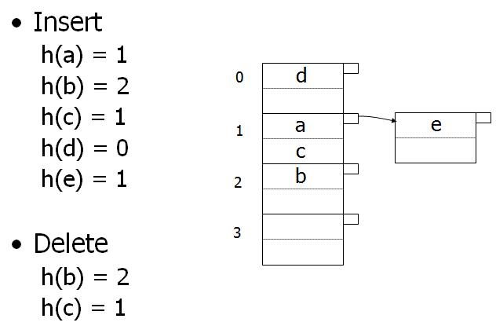
Static Hashing
Assume 2 records per bucket.

Slide 6
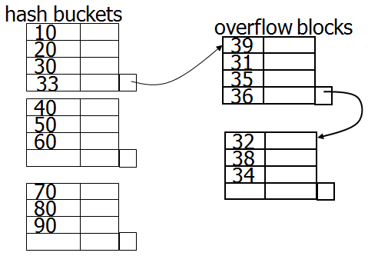
Static Hashing
Large overflow blocks cause problem!

Slide 7
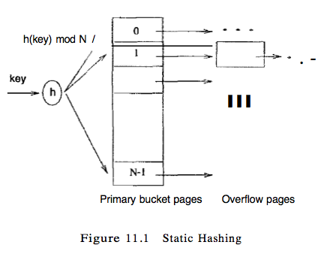
Extendible Hashing
We don’t want overflow chains.
What if we just rehash everything when our buckets get full?
Instead of mod N use mod N+1
Problem!
Have to rehash everything!
Have to rewrite pages.
Solution! Indirection!
Use a Directory.

Slide 8
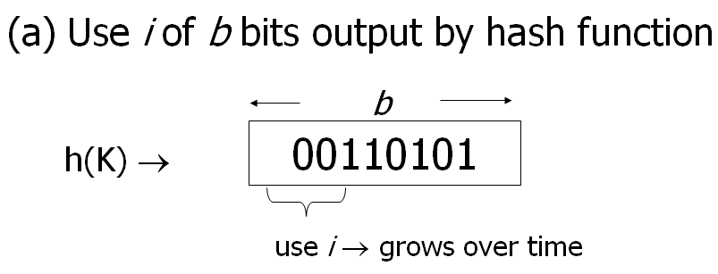
Extendible Hashing

Slide 9
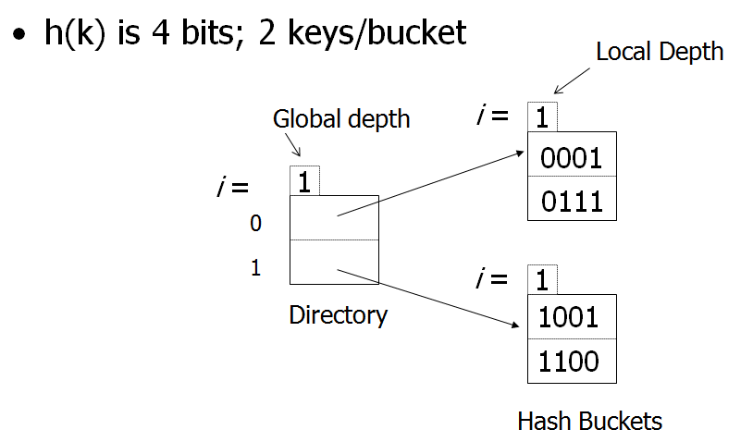
Extendible Hashing

Slide 10
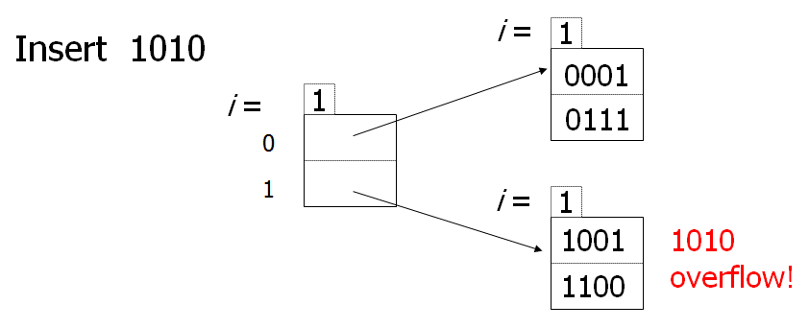
Extendible Hashing

Slide 11
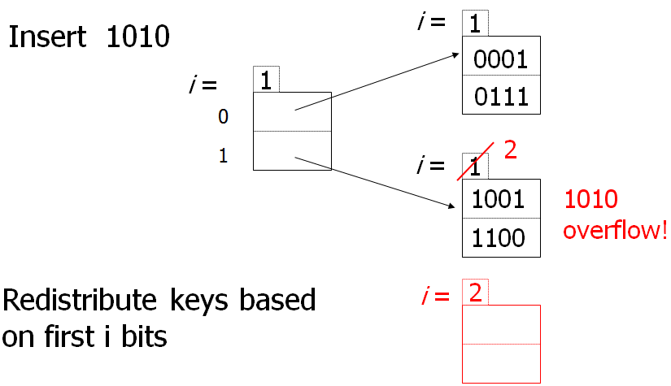
Extendible Hashing
Split Image
Notes:
increase local depth to 2 and create another depth-2 block. redistribute based on 2nd bit

Slide 12
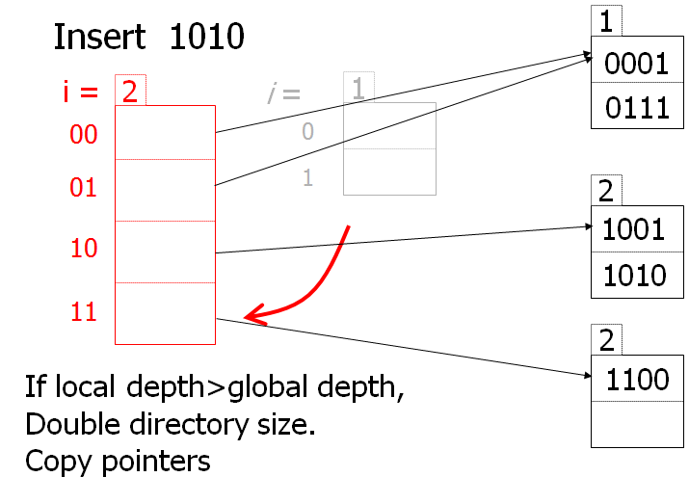
Extendible Hashing
Notes:
Now: local depth 2 is greater than global depth 1, so increase directory size

Slide 13
Extendible Hashing
Normal insert - simple!
Look up the right page and write to it.
Insert to a full page - sophisticated!
Redistribute the contents of the full page onto two new pages, increment local depth pointer.
If local depth <= global depth, update directory to point to two new pages.
Otherwise, double the size of the directory.
Update pointers to go to new page.
Note we’re doubling the size of the directory, which is probably small relative to our data pages.

Slide 14
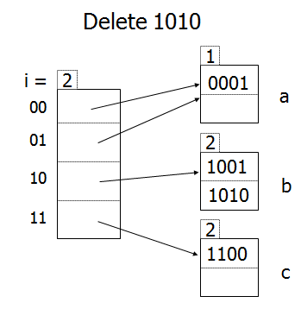
Extendible Hashing - Delete

Slide 15
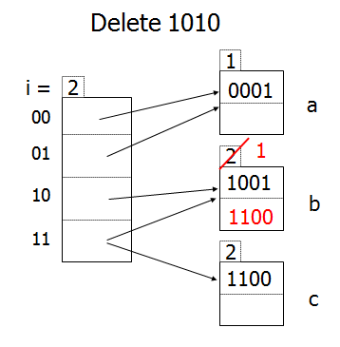
Extendible Hashing – Merge buckets
Notes:
Now we can merge b + c

Slide 16
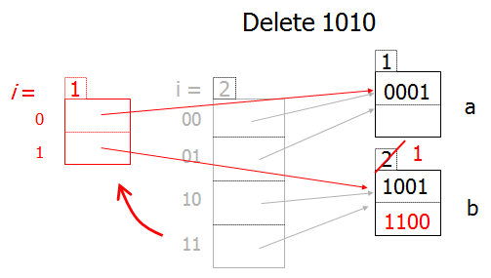
Extendible Hashing – Shrink Directory

Slide 17
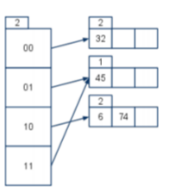
Practice
Notes:
32: 0b100000
45: 0b101101
6: 0b110
74: 0b1001010
Note 01 and 11 point to same block (45) - local depth is also 1
2 in the 00 block
1 in the 10 block
2 in the 01 block, but note that 11 also points to it because local depth is 1 (and can thus be increased)
so add 3 more in that case
total: 2 + 1 + 2 + 3 = 8
Mathy way to view it: 3 keys per bucket, 4 buckets max = 12 maximum keys, but only 4 used right now. so room for 8!

Slide 18
True or False?
Notes:
False!
You’re right in that static contains overflow pages...
but so can extendible, if too many records have the same hash value!
sorry, a bit of a trick question :D

Slide 19
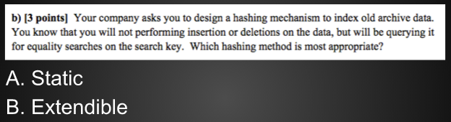
Which one is better here?
Notes:
Static!
Why?
Extendible introduces more indirection (more levels) as well as local/global depths. This is all more overhead (and is especially bad if the directory doesn’t fit in memory)
Static’s main drawback is that it performs terribly as updates are made, but there are no updates here!
Previous three questions come from a Berkeley midterm (Spring 2011 Franklin 3b)
https://tbp.berkeley.edu/exams/3214/download/
Covers linear hashing which we haven’t discussed, so don’t mind that for now

